Slide 1
MindBridge: Cross-Subject fMRI Representation Learning
Synthetic Noise Modeling & Real Movie Analysis
Syed Ismael & Munir Hussain
UET Taxila
Supervisor: Dr. Hassan Dawood
February 2026
Syed Ismael & Munir Hussain (UET Taxila SupervisoMindBridge: Cross-Subject fMRI Representation Lear
ning

Slide 2
Problem Statement & Motivation
The Challenge: Brain activity is unique across subjects, making cross-subject decoding difficult.
The Gap: Standard synthetic fMRI models ignore realistic acquisition noise like thermal and physiological artifacts.
Goal: Learn a shared latent space to align brain patterns while modeling realistic noise.
Syed Ismael & Munir Hussain (UET Taxila SupervisoMindBridge: Cross-Subject fMRI Representation Lear
ning

Slide 3
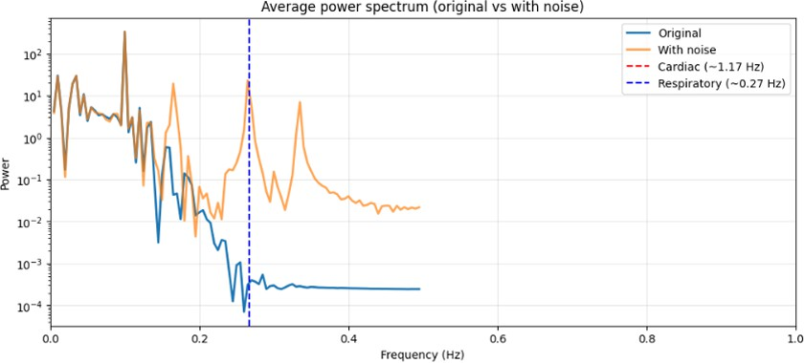
Phase 1: Synthetic Noise Modeling
Objective: Create synthetic data that mimics real-world acquisition conditions.
Components:
Thermal Noise Physiological Noise Spatial Noise (Drift)
Result: Successfully matched the 1/f spectral structure of real fMRI.
Average Power Spectrum Alignment
Syed Ismael & Munir Hussain (UET Taxila SupervisoMindBridge: Cross-Subject fMRI Representation Lear
ning

Slide 4
Phase 2: Dataset & Preprocessing
Dataset: OpenNeuro ds000228 Pixar Movie-Watching (5 subjects).
Preprocessing Pipeline:
EPI Masking: Isolating 40,000 brain voxels.
High-Pass Filtering: Removing artifacts below 0.01 Hz.
Normalization: Voxel-wise Z-scoring.
Temporal Trimming: Stabilizing signals.
Syed Ismael & Munir Hussain (UET Taxila SupervisoMindBridge: Cross-Subject fMRI Representation Lear
ning

Slide 5
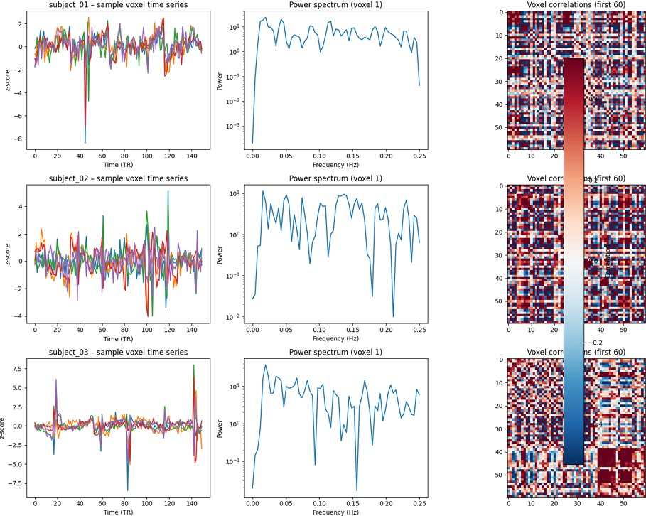
VAE Representation Learning
Architecture: 30,000 input voxels compressed into 64-D Latent Space.
Model: Fully connected Variational Autoencoder.
Observation: Rapid convergence with ”Posterior Collapse” (KL ≈ 0).
Sample Voxel Time Series
Syed Ismael & Munir Hussain (UET Taxila SupervisoMindBridge: Cross-Subject fMRI Representation Lear
ning

Slide 6
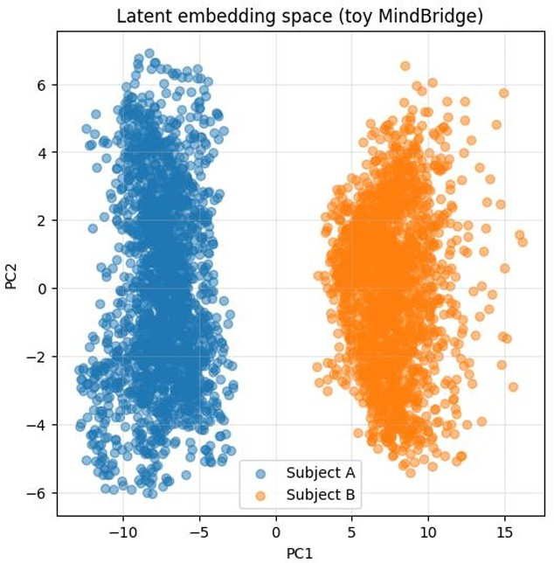
MindBridge: Cyclic Mapping Performance
Concept: Enforcing Cycle Consistency (A to B to A).
Loss: Cycle Loss + Identity Loss.
Achievement: Near-perfect alignment (MSE ≈ 0.001).
Latent Space Alignment
Syed Ismael & Munir Hussain (UET Taxila SupervisoMindBridge: Cross-Subject fMRI Representation Lear
ning

Slide 7
Conclusion.
Successfully compressed high-dimensional fMRI data into a 64-D latent space
Achieved strong cross-subject alignment (MSE ≈ 0.001)
Demonstrated that latent representations can be aligned across individuals
However, decoding performance remained near chance level
Alignment alone is not sufficient for meaningful semantic decoding
Stronger supervision and richer labels are needed in future work
Syed Ismael & Munir Hussain (UET Taxila SupervisoMindBridge: Cross-Subject fMRI Representation Lear
ning

Slide 8


Any Question.

